Slide 1
Test cases -Sprint 1
Team 4- Whisk and Drizzle
Here is an overview of the testing:
“We have tested five key features of the application, including sign-up, login, reset password, update user details , admin login(with dash board feature) add products, delete products, and add products to the feature part inn home page. These features are functioning as expected.
Testers:
Sivasankaran Kaleeswaran
Mudra Koradia

Slide 2
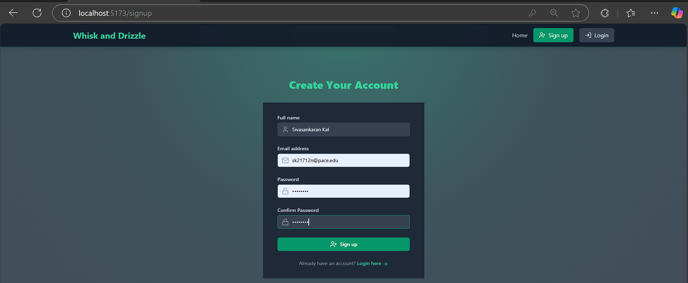
Test case 1: Sign up

Slide 3
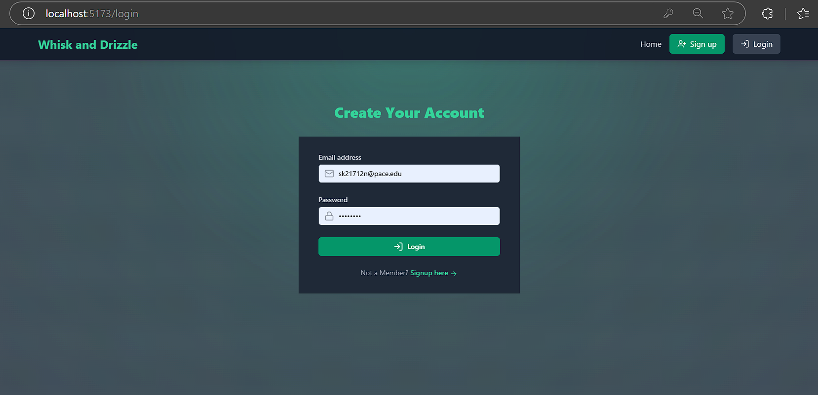
Test case 2: sign in

Slide 4
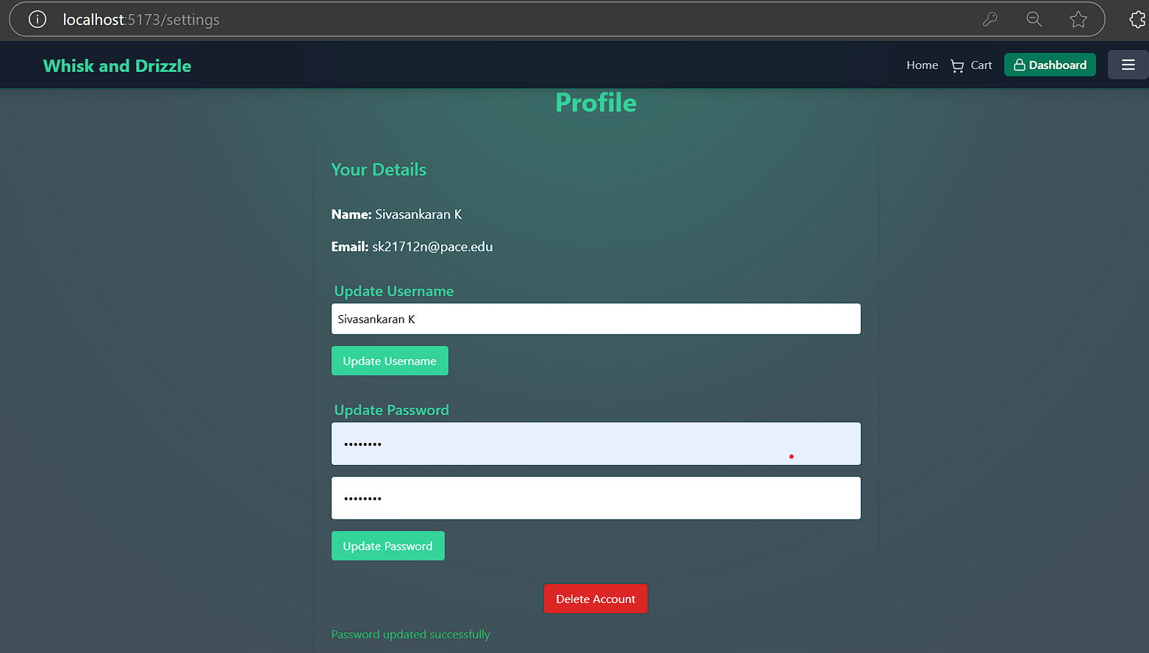
Test case 3: Password Reset

Slide 5
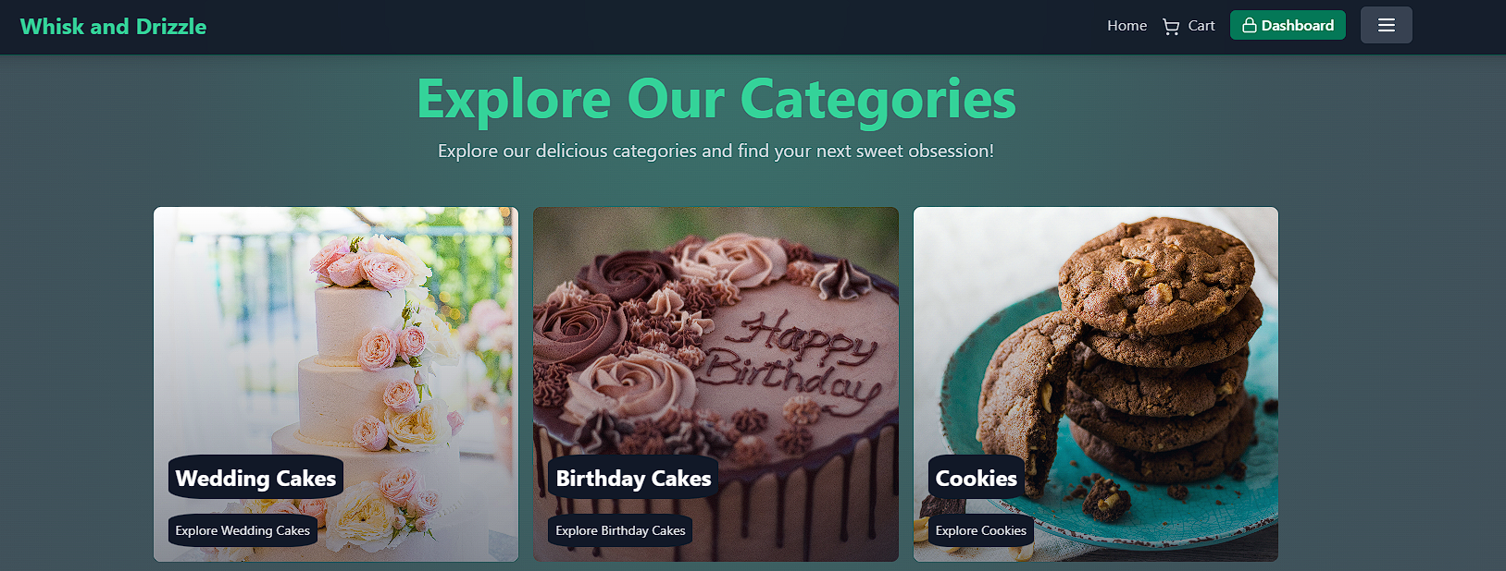
Test case 4: Admin Login (with dashboard feature)

Slide 6
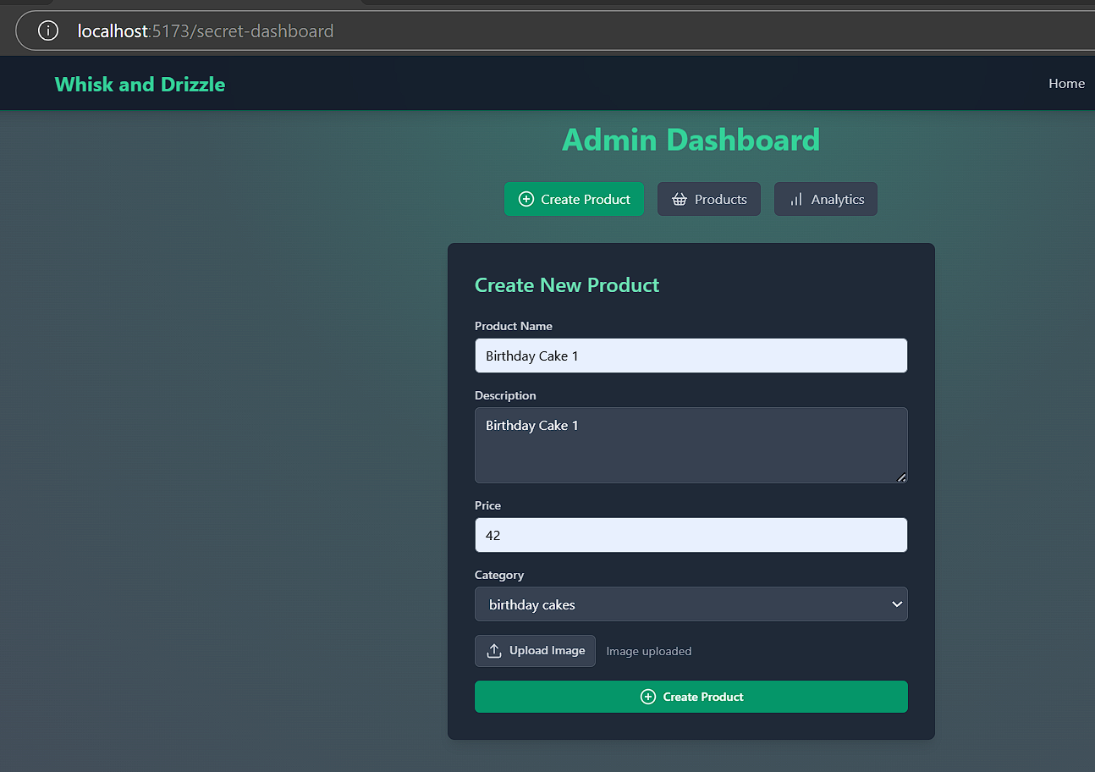
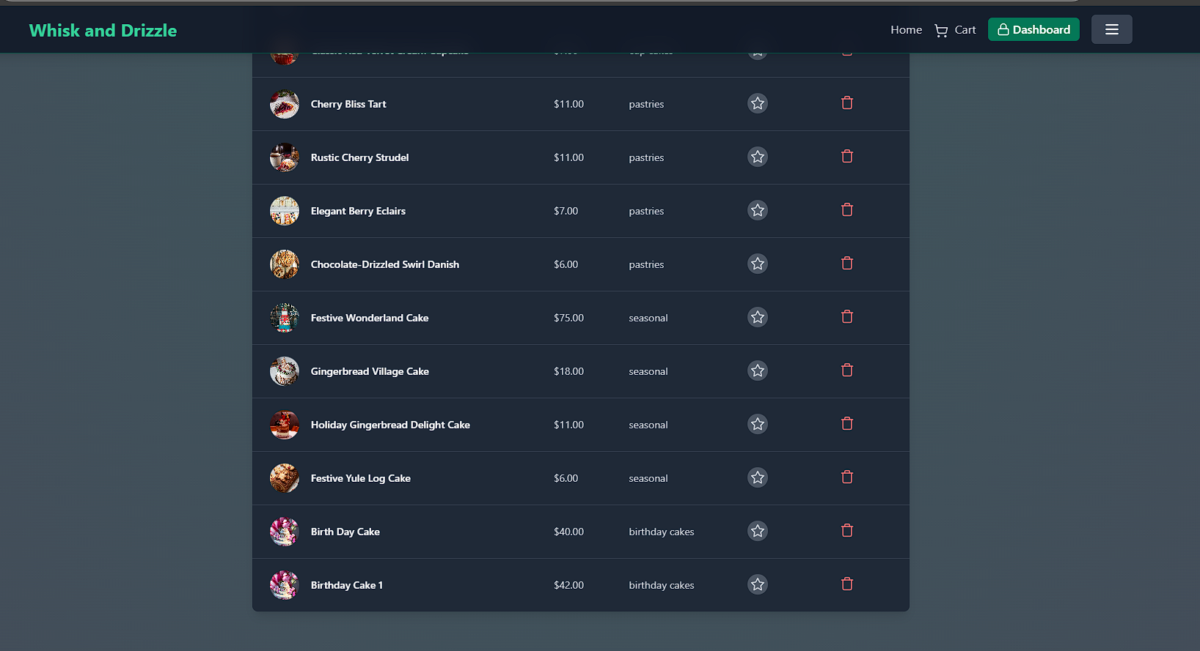
Test case 5: Create Product

Slide 7
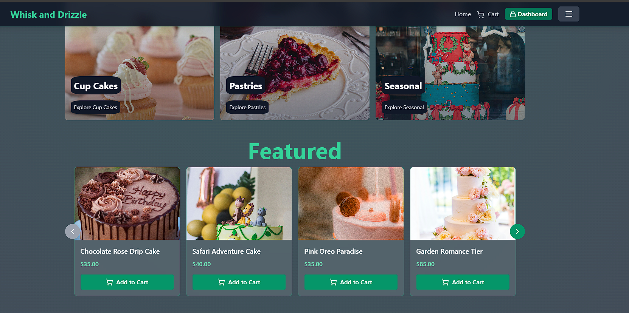
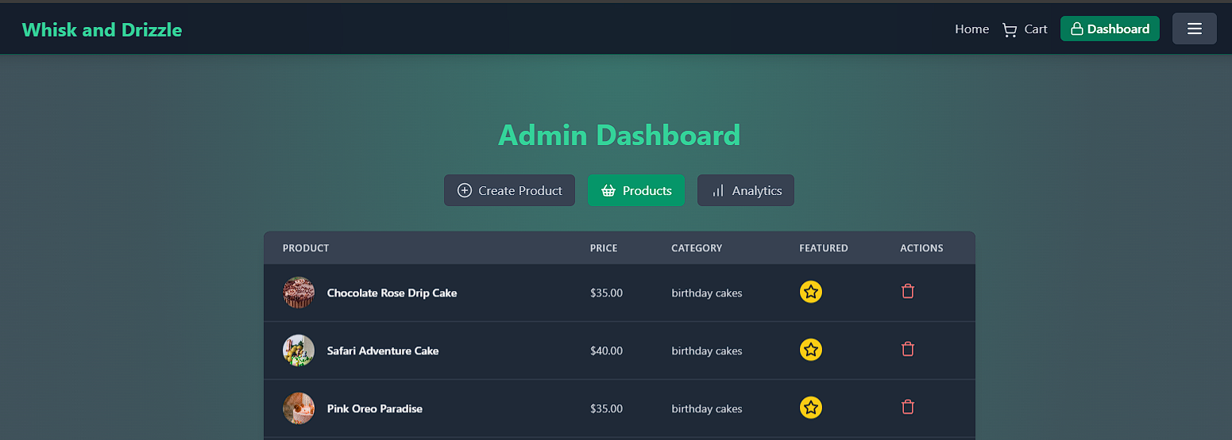
Test case 6: Feature Product

